Slide 1
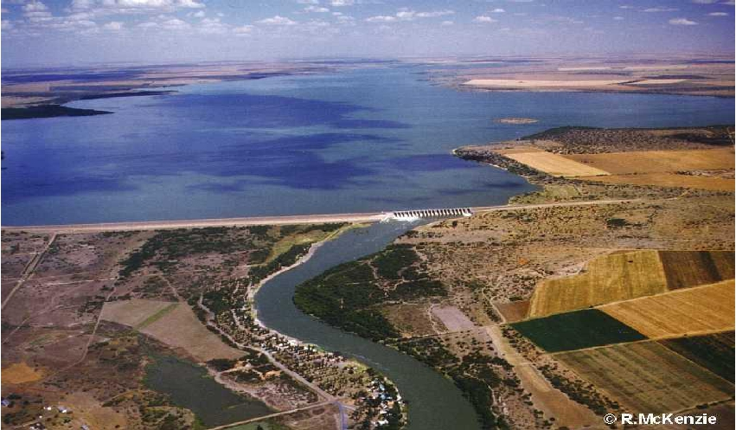
Shankersinh Vaghela Bapu Institute of Technology
(075)
Water Conveyance System
Branch - Civil
Guide – Dorin Parmar
Group members
NIRAV JAYANTIBHAI DHANDHUKIA
SHELADIA MIHIRKUMAR KISHORBHAI
NAIR VIDYA SIVADASAN

Slide 2
Water Conveyance System
Water Conveyance System
•
Canals
Conduits
• Canals-Canals are the structure constructed to
carry or transport water from the reservoir to
the area which is to be irrigated
• Conduits- A pipe is close conduits used to carry
water under pressure.

Slide 3
Canals
• Classification of canal
• Classification based on source of supply
i) Permanent Canal
ii) Inundation canal
Permanent canal is one which is fed by a
permanent source of supply
Inundation canal usually draws supplies
whenever there is flood

Slide 4
• Classification based on function
• Irrigation canal- carries water to
agriculture fields
• Feeder canal- feeds another canal
• Navigation canal- provides navigation
facilities

Slide 5
• Classification based on origin of canal in a
canal network
• Main canal-carries water from reservoir
• Branch canal- when a main canal reaches area to
be irrigated it gets divided into branches joining
different parts of the area
• Major distributary- these are small canals taking
off from branch canal it supplies water to outlet
• Minor distributary-this are small channels
supplying water to water courses for irrigation
• Field channels-from this channels, water enters
into the field of cultivator

Slide 6
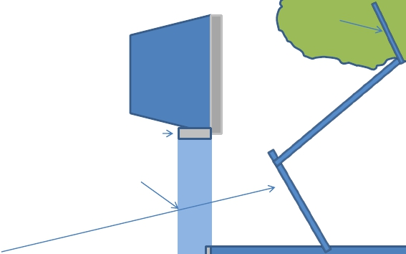
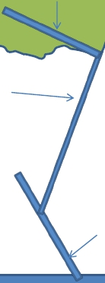
Canal network
Field
Channel
Field Channel
Head regulator
Main Canal
Minor
distributory
Major
distributory
Branch Canal
Cross
regulator

Slide 7
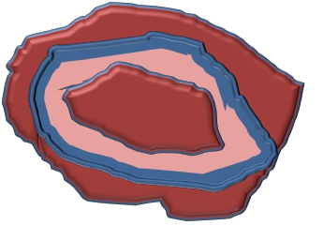
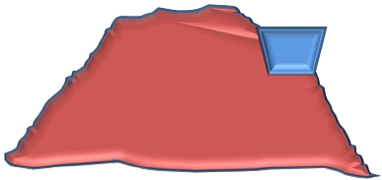
• CLASSIFICATION BASED ON ALIGNMENT
• Contour canal-In this alignment the canal generally
follows a
contour except for
necessary slopes.
• Main canal runs as
a contour canal
• Contour canal requires
Cross drainage works
Besides this it can
irrigate on one side only

Slide 8
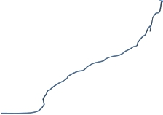
• Ridge canal- The canal aligned along natural
watershed is known aas ridge canal.
• It irrigates on both sides, C.D. works can be
avoided

Slide 9
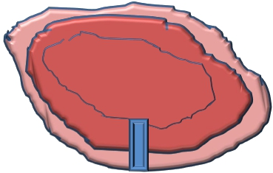
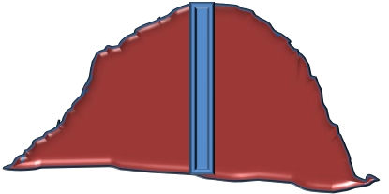
• Side long canal- In this alignment canal is
across contour
• No cross drainage
works are required

Slide 10
Canal regulation works
• The structure constructed to regulate the flow into
the canal network are called as canal regulators
• 1) Canal head regulator The structure constructed to
divert the water from the reservoir into the Main
canal is called as Head regulator
• Function of head regulator is to control the entry of
water from reservoir
• To control the entry of silt
• To serve as a meter for measuring discharge

Slide 11
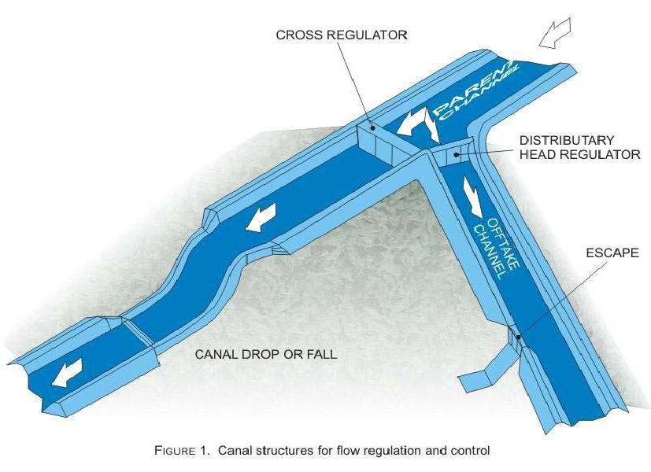

Slide 12
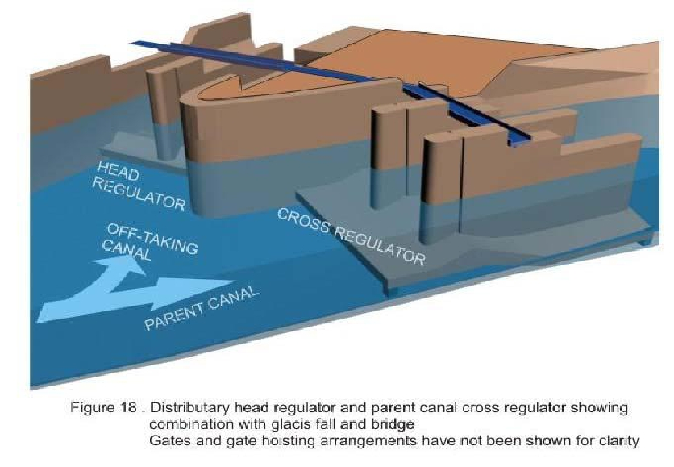

Slide 13
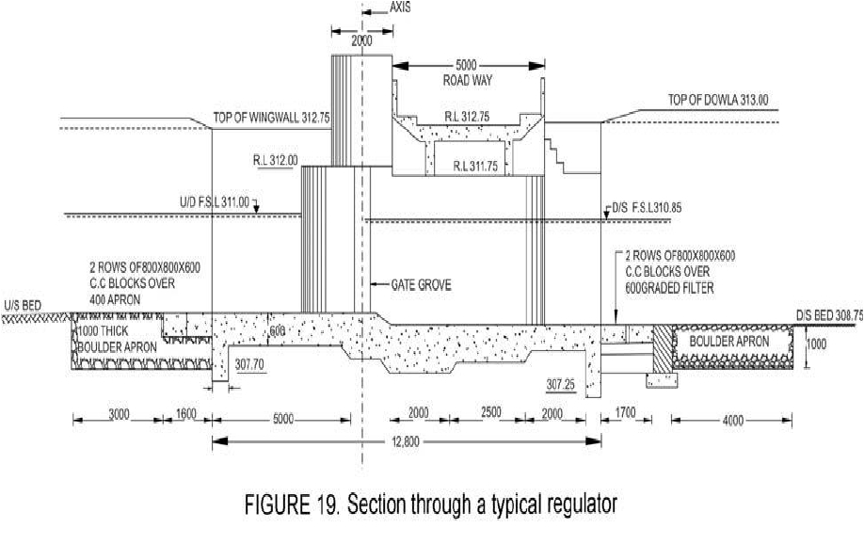

Slide 14
• Cross regulator:- A regulator constructed into
the main canal or parent canal u/s of the
branch canal so as to control the entry of
water in branch canal is called as cross
regulator.
• Canal Escape:- Irrigation structures
constructed to escape water from the canal
into some natural drain is called canal escape

Slide 15
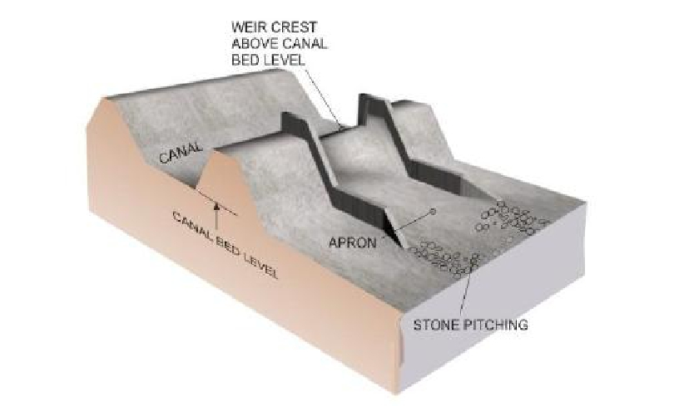
Canal Escape

Slide 16
• Fall and rapids:-
• Fall or rapids are located on the d/s side of the
channel. It becomes necessary to lower the
bed level of canal when the slope of the
ground is steeper than gradient or slope of the
canal.
• Fall:- A fall is structure constructed across a
canal to permit lowering down its water level
and dissipate the surplus energy by falling
water.

Slide 17
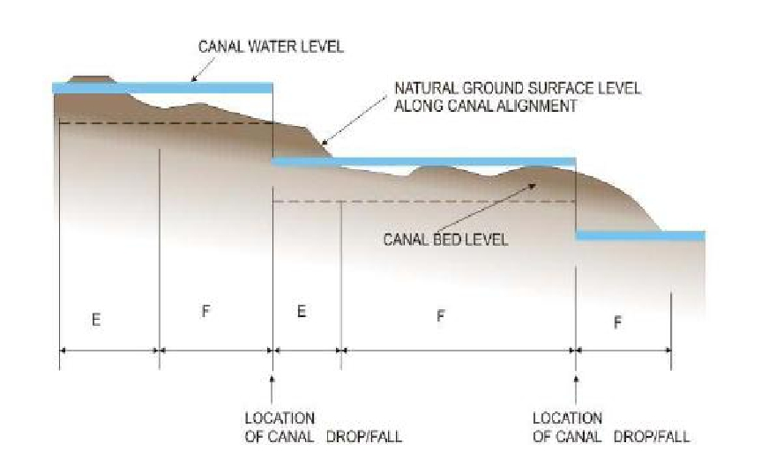

Slide 18
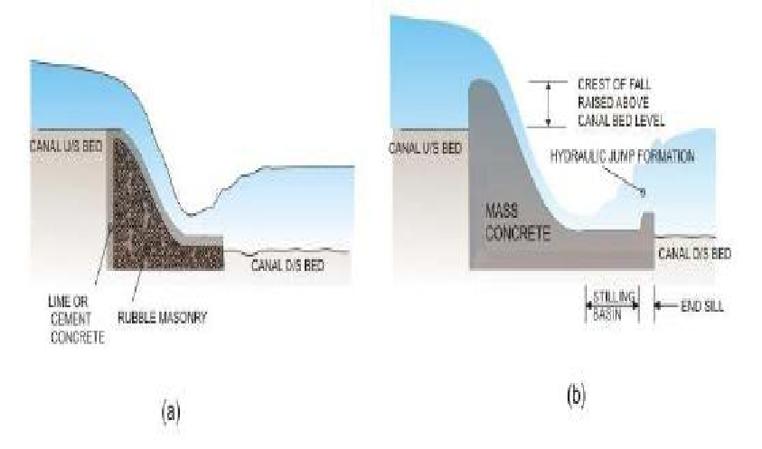
Fall

Slide 19
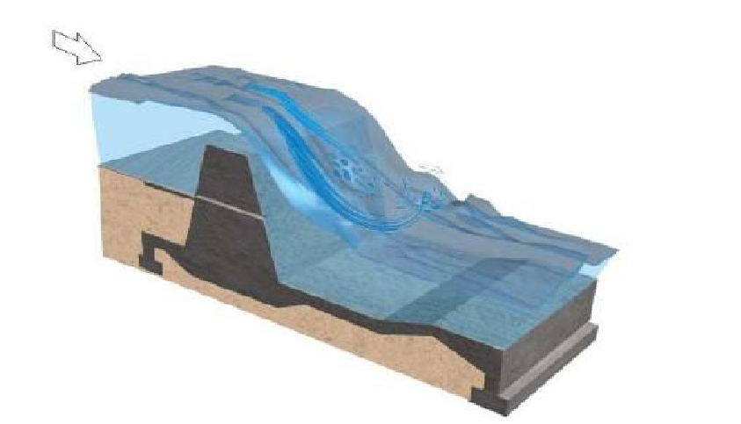
Vertical Drop Fall

Slide 20
• Rapids:- A rapid is a structure constructed to
permit lowering of water level by providing a
sloping ramp of some length this sloping ramp
is called Rapid.

Slide 21
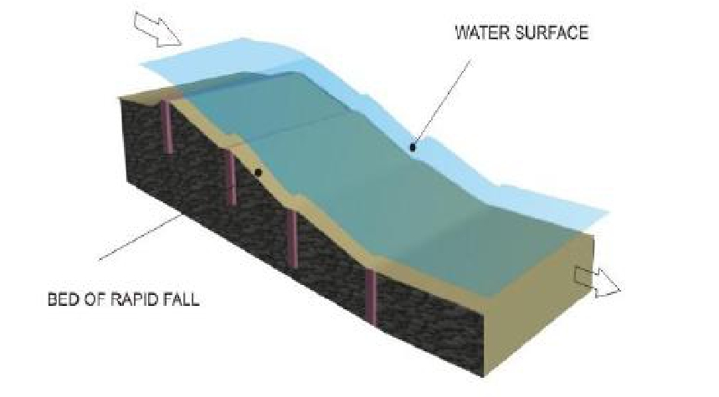

Slide 22
Cross drainage works
• Irrigation structures constructed for carrying
the canal water safely over or under the
drainage water are called as cross drainage
works.
• When a canal is taken off from the reservoir it
meets various natural drainages so cross
drainage works are required to be constructed

Slide 23
Aquaduct
• The irrigation structure constructed for
passing canal water safely over the drainage
water is called an aquaduct
• Aquaduct are constructed in following
situations
• Drainage is more as compared to canal water
• The bed of the canal is sufficiently above the
high flood level in the drain.

Slide 24
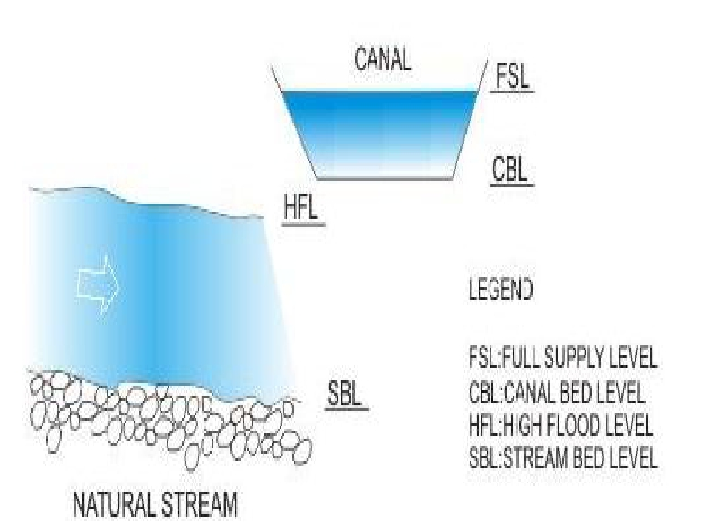

Slide 25
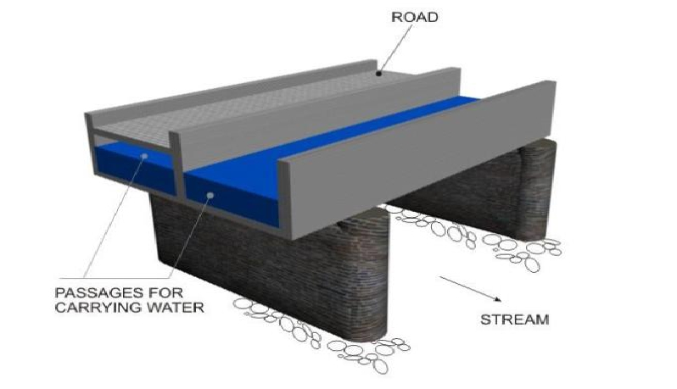
Aquaduct

Slide 26
Syphon Aquaduct
• When high flood level of drain is much higher
above the canal be, the drain is then syphon
i.e. the bed of the drain is depressed below the
crossing.

Slide 27
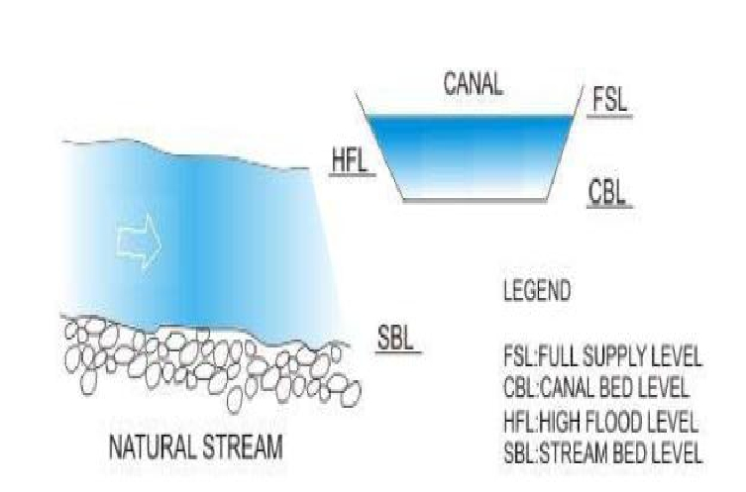

Slide 28
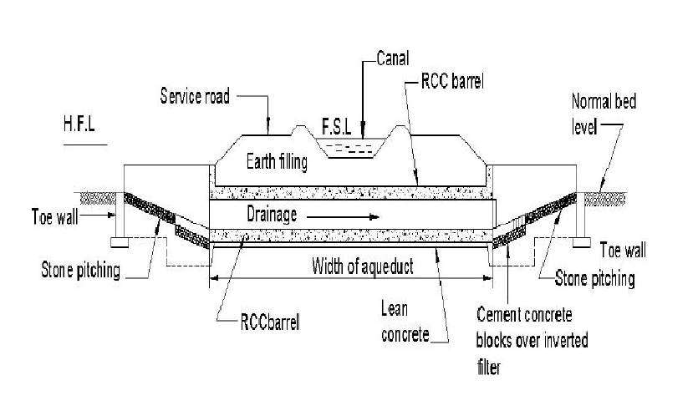

Slide 29
Super passage
• When the drainage water is taken over the
canal, the structure is called super passage. It
is just reverse of aquaduct.

Slide 30
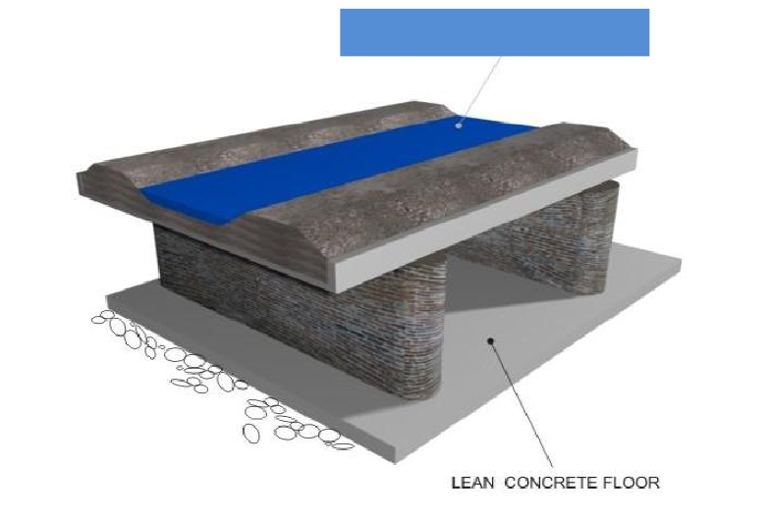
Drainage water
Superpassage

Slide 31
• Syphon superpassage:- In this case the
canal bed is depressed and ramp is provided
at the exit
• Drainage bed level is at higher lower than full
supply level of canal

Slide 32
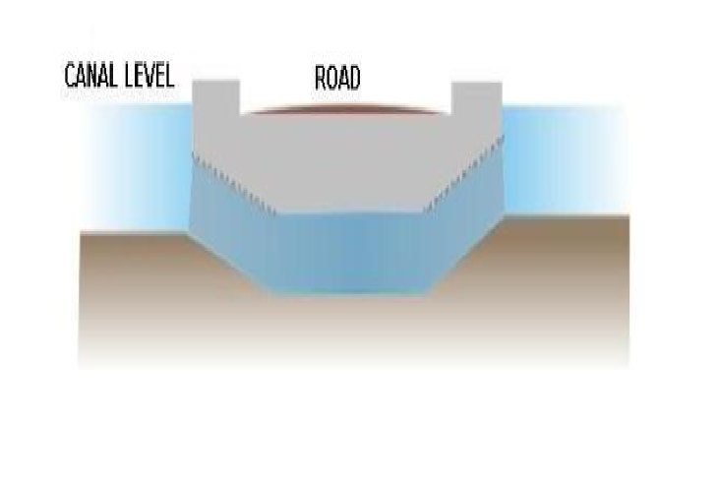

Slide 33
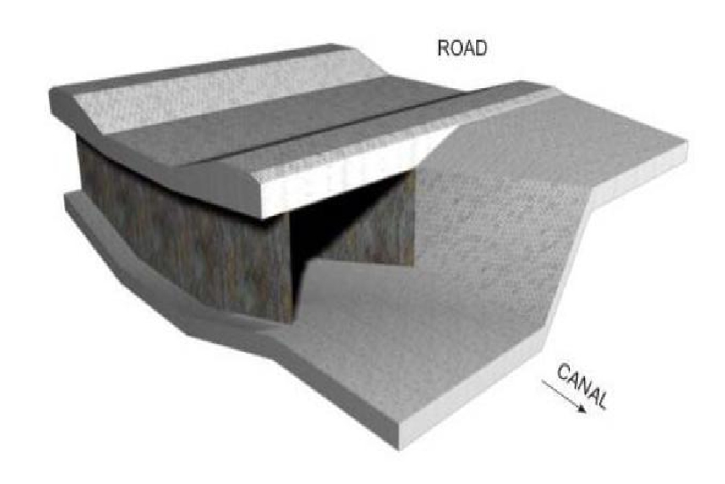
Syphon super passage

Slide 34
Level crossing
• When canal bed level and drain bed level are
practically the same, drainage water is
allowed to intermingle with the canal water
• Such type of works is known as level crossing.

Slide 35
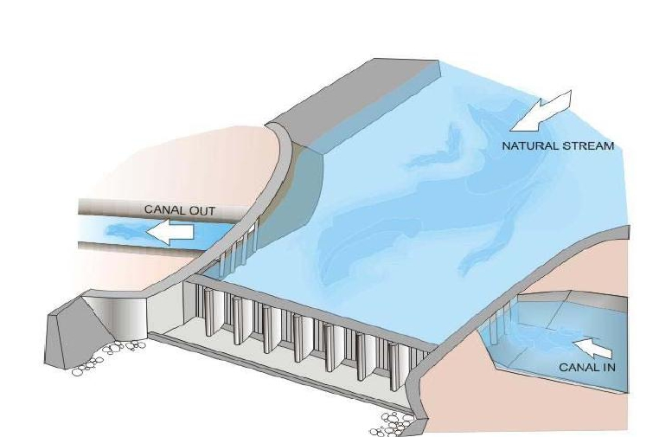

Slide 36
Inlet and out let
• Inlet is provided in the canal to admit drain
water into it.
• It is provided in following situations
• Drain water is less in magnitude
• Drain water is free from heavy silt
• The drainage bed level is lower than F.S.l

Slide 37
Outlet
• It is possible to escape out same quantity of
water through some outlet nearby d/s. out let
is provided on the bank of canal to dispose off
excess water admitted in the canal through
inlet.

Slide 38
Water conduit
• A pipe is a close conduit, generally circular in
c/s used to carry water under pressure.

Slide 39
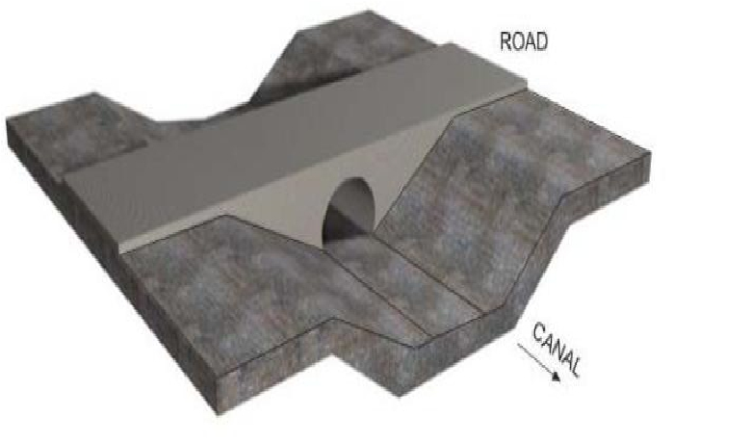

Slide 40
•Thanks

